Slide 1
2024 USPS
Calendar Year End

Slide 2
REMINDER
Although the software is now written to permit districts to create and submit their own SSA, Ohio, City RITA, CCA, and State files, ACCESS will continue to submit all data to the respective entities on behalf of the districts.

Slide 3
PRELIMINARY CYE CLOSING PROCEDURES

Slide 4
NEW – SSN Verification
Allows a submission file to be created that can be uploaded to Social Security Administration’s Business Services Online.
See alert section on BSO website regarding account login information.
Once you receive the file back from BSO, use the second option to load the results.

Slide 5
DECEMBER UPDATES
Update to W2 processing so a payroll item is not included if values are all zeroes.
W2 Report and W2 City is updated to display and allow selection of Tax Entity Codes from a dropdown.

Slide 6
Life Insurance Premium
Process Life Insurance Pay Types for employees that are provided life insurance premiums over $50,000 before your last payroll of the calendar year
Notes:
According to the IRS, the cost of group-life insurance an employer provides to an employee for coverage over $50k is to be included in wages reported for the employee.
The tax amounts for Medicare and SS will be calculated, but no Federal, State, or OSDI tax amounts will be calculated. The software provides ability to withhold city tax and can be activated by checking the “Tax Non Cash Earn” box on the city tax record box under Core > PR Item Configuration.

Slide 7
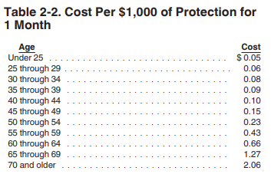
IRS publication 15-B
Example: 35 year old principal has $250,000 group term life insurance for an entire calendar year
$250,000 - $50,000 = $200,000 excess coverage
$200,000 / $1000 = 200
$.09 cost per month x 12 months = $1.08
$1.08 x 200 = $216 non-cash earnings amount
2023 Publication 15-B (irs.gov)
Notes:
If the Life Insurance Premium Pay Type was not posted prior to the last pay, then adjustments will need made to the 001 Federal Payroll Item under Core > Adjustments. Put in a ticket and we will provide directions.

Slide 8
OSDI Code
Schooldistricts2023.Pdf (ohio.gov)

Slide 9
City Tax W2 Abbreviation
Notes:
ALL cities need to have Tax Entity Code. Contact the city tax department regarding their entity code if you have any questions.

Slide 10
Rita Code
Tax Rates Table - Regional Income Tax Agency (ritaohio.com)

Slide 11
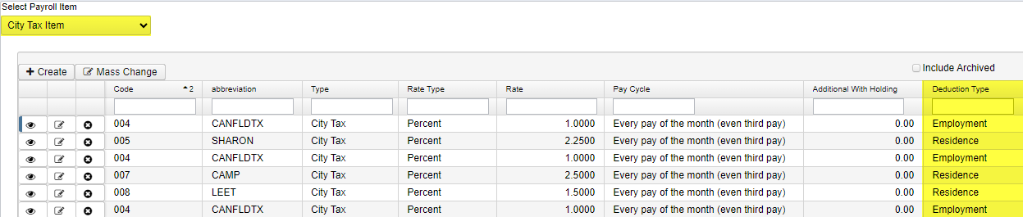
Residence vs Employment
Notes:
Core > Payroll Item > Payroll Item. Select City Tax Item from dropdown.
Verify Employment or Residence is entered, can use Advanced Query to search for this.

Slide 12
Check Legal Name Field
Notes:
*Not on checklist!*
Legal Name fields can be used if the name that needs to be printed on W2 differs from the name desired on the employee’s check.
Core > Employee > More > Legal Name > add First and Last Name to grid.
Use Advanced Query to find anyone with Legal Name fields filled out and verify.

Slide 13
Month end closing
Follow normal Month End closing checklist and procedures

Slide 14
Quarter end closing
Follow normal Quarter End closing checklist and procedures
Verify ODFJS Report, generate submission file, upload to secure site
Balance Quarter Report
Complete and file required Quarter End/Annual submission forms

Slide 15
Payroll Item Balancing

Slide 16
OAPSE Report
Generate the OAPSE report and save for reporting of annual wages to OAPSE

Slide 17
W2 Processing

Slide 18
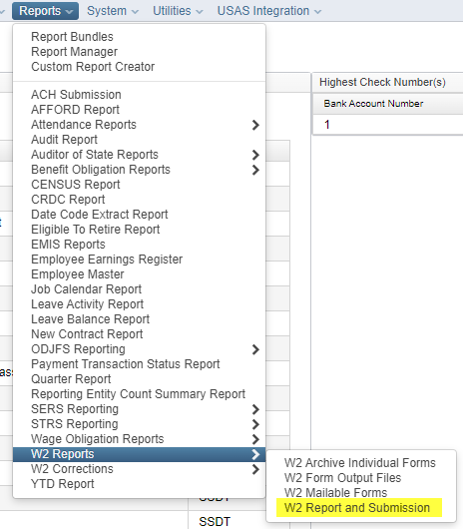
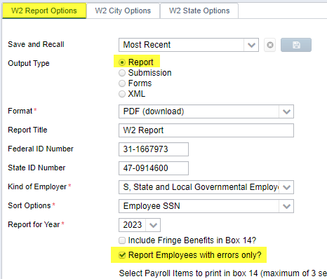
W2 Report and Submission Error Report

Slide 19
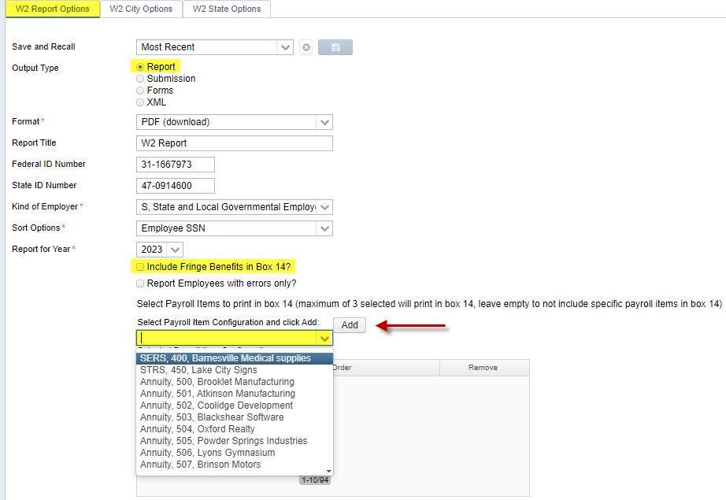
W2 Report and Submission
Notes:
When running just the report, can check “Include Fringe Benefits in Box 14” and select the PR Items to print on the report.
View W2 Report Summary > Tax Withheld.
Can run an Earnings Register for the whole year and look at the Employee Amounts under Payment Totals.
Can also use Quarter Report and look at the YTD Totals under Deduction Item Summary.

Slide 20
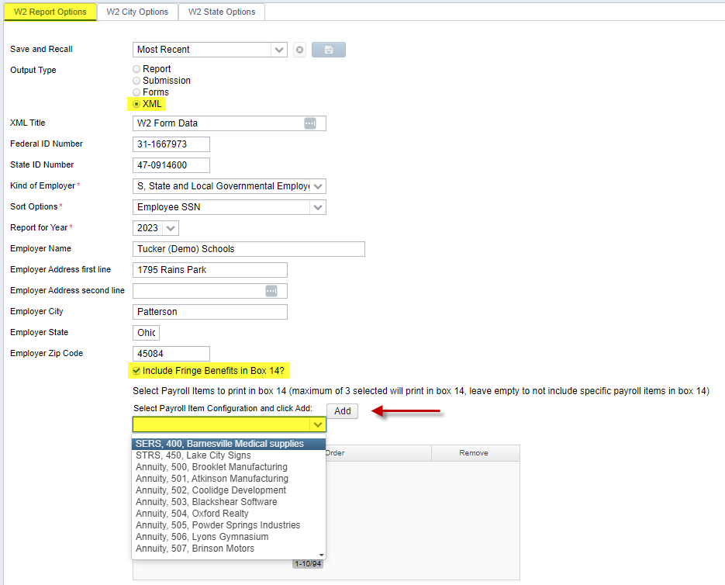
Create W2 XML File
Notes:
Output is W2 Form Data.XML

Slide 21
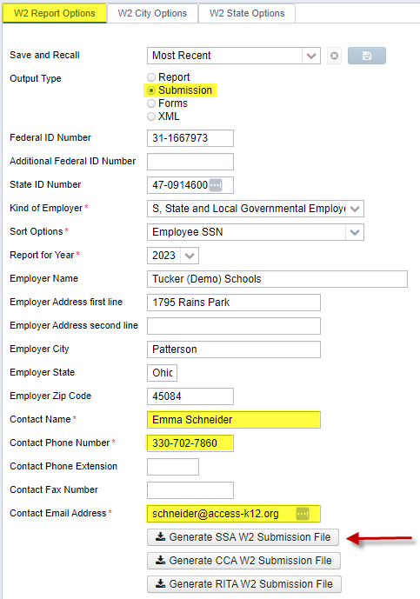
Create W2 Federal Submission File
Notes:
Output is W2TAPE.TXT

Slide 22
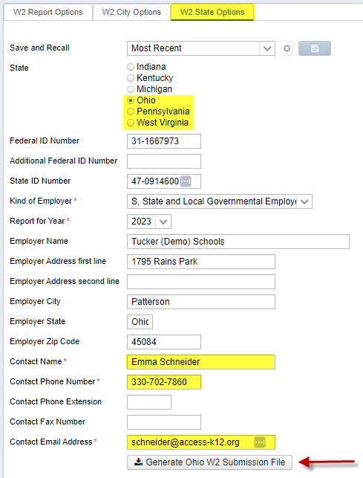
Create W2 State Submission File(s)
Notes:
Output is W2OH.txt

Slide 23
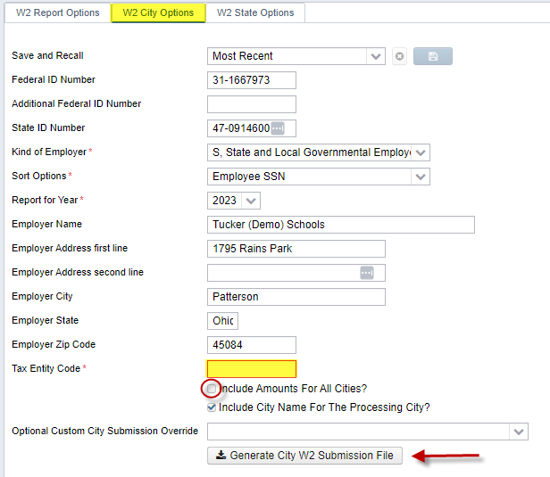
Create W2 City Submission File(s)
Notes:
Most cities like this checked, but you can verify with the city if they need this information.
Output is W2CITY_XXXXX.TXT

Slide 24
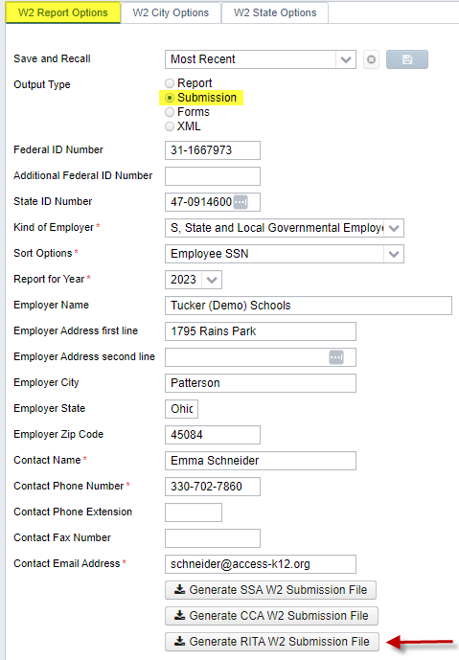
Create W2 RITA Submission File
Notes:
Output is W2RITA.TXT

Slide 25
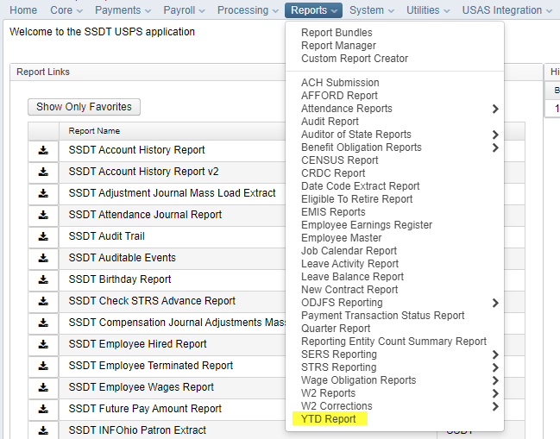
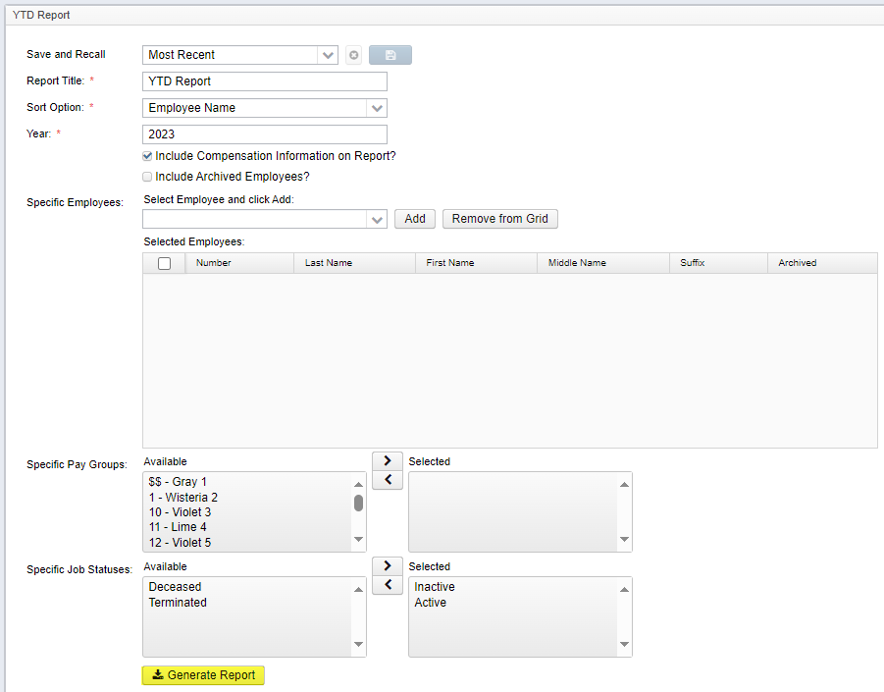
YTD Report – Earnings and Benefits Report

Slide 26
Final Reminders
Deadline to upload files to the secure site:
Friday, January 10, 2025
Federal submission files (.xml & .txt)
State submission files (.txt)
City submission files (.txt)
RITA submission file (.txt)
Ohio Minimum Wage increasing Jan. 1, 2025 to $10.70/hour
Notes:
Files to be uploaded to the secure site by Friday, Jan. 10:
-Federal submission files - .xml and .txt
-State submission files - .txt (we only submit Ohio on your behalf, you submit other states yourself)
-City submission files - .txt (Canfield)
-RITA submission file - .txt
Post Closing:
Verify Report Bundles - Utilities > File Archive > Payroll Archive > filter by year > click 2023 - Calendar Year Reports

Slide 27
Merry Christmas &
Happy Holidays

